Slide 1

Protocol Design Considerations
Version 1, Presented at QuTech (Delft) on 22 November 2019

Slide 2
A few true stories…

Slide 3
Designing correct protocols is hard
On 27 October 1980, all routers in the entire Internet had to be rebooted simultaneously to recover from a protocol design weakness.
http://www.hannaypublications.com/portfolio/wp-content/uploads/2016/02/AppliedComms_A2.pdf

Slide 4
Version numbers to pick newest message
Message
Version number 8
<
Message
Version number 40
<
Message
Version number 44
Oldest version
Newest version
Note: this mechanism is still used today, for example in OSPF and ISIS link state flooding

Slide 5
Modulo 64 comparison creates ”version loop”
Message
Version number 8
44 < 8
(modulo 64)
8 < 40
(modulo 64)
Message
Version number 44
Message
Version number 40
40 < 44
(modulo 64)
Version field was unsigned 6-bit integer, so math is modulo 64
Competing message versions kept replacing each other forever, eating up all CPU
The versions were introduced to a double bit error, which was not detected because check-sums were disabled.

Slide 6
We have not quite yet learned our lessons
A similar problem exists in the BGP specification and is observed in the Internet to this day.
See BGP persistent route oscillations (RFC3345)

Slide 7
Implementing protocols correctly is hard
A bug in a widely used BGP implementation allowed an attacker to advertise a BGP route that caused many BGP routers on the other side of the world to crash.
Sending a specially constructed 4-octet AS-path caused certain routers to crash CVE-2014-3818 https://securitytracker.com/id/1031009

Slide 8
Protocol security is hard
A BGP vulnerability enabled hackers to rob a bitcoin bank.
https://www.wired.com/2014/08/isp-bitcoin-theft/

Slide 9
Flow control Congestion control Error control (reliability) in the data plane

Slide 10

Flow control
Make sure the sender does not produce data faster
than the receiver can consume it.
Consume 3 pps
Send 5 packets per second (pps)
Receive buffer overflows.
Buffer can absorb bursts but not sustained rate difference.
Drop 2 pps
Note: here it is the receiver that is not keeping up; the network can keep up fine.

Slide 11
Flow control in quantum network
Make sure sender does not produce qubits faster
than receiver can consume them.
Bell pair
Ideally, it is produced “fresh” just before we have a qubit to teleport
Qubit that has been teleported
Receiver needs to store it in memory until it is consumed (measured)
Qubit to be teleported
Sender never stores more than one “qubit to be sent” in memory
Consumer can run out of qubit memory ifs sender sends qubits
faster than received consumes (measures) them.
[Animation]

Slide 12
Flow control approaches
General principle: make the data arrive more slowly
Approach 1: Sliding window
Receiver makes the sender slow down by delaying permission to send
It is okay to receive data later (delay in-sensitive traffic)
Web pages, file transfer, e-mail, …
Approach 2: Adaptive encoding
The sender sends less data by switching to more lossy compression
It is not okay to receive data later (delay-sensitive traffic)
Voice, live video, video on demand, …
Sender must be able to back-pressure application

Slide 13
Sliding window
Window size = 5
Buffer size 5
Window size = 3
Window size = 0
Window size = 2
Consumed

Slide 14
Bandwidth-delay product
100 Gbps, 5000 km (= 50 ms round-trip @ speed of light in fiber)
window size 800 Mbit @
100 Gbps = 8 ms
Round-trip time 25 ms
Window size must be ≥ bandwidth * round-trip delay to fully utilize available bandwidth.
In this example window size (= receive buffer size) is 100 MB = 800 Mbit
Only 32% of available bandwidth is used.

Slide 15
Congestion
Make sure senders do not produce data faster
than network can carry it.
Send link-rate
Send link-rate
Try to send 2x link-rate traffic on link.
Transmit buffer overflows.
Drop half of traffic.

Slide 16
Congestion control
Congestion avoidance: avoid congestion in the first place
Congestion mitigation: deal with congestion when it does occur
Worst case scenario: congestive collapse
Effective capacity of the network to carry useful traffic drops to zero
Retransmissions due to excessive drops and queueing delays overwhelm network
More likely to happen when capacity is low compared to demand (as it will be in early quantum networks!)
This actually happened in the early internet: the capacity collapsed from 32 Kbps to 40 bps (not Kbps) https://blog.acolyer.org/2015/05/21/congestion-avoidance-and-control/ https://tools.ietf.org/html/rfc896

Slide 17
Congestion avoidance
Congestion avoidance: mechanisms to avoid congestion in the first place
General principle: send traffic more slowly when congestion occurs
TCP congestion control
TCP tries to estimate maximum rate before congestion occurs
TCP sender dynamically congestion window based on presence or absence of drops
Extremely difficult to get right: Reno, Vegas, BIC, CUBIC, …. and many more algorithms
Assumes everyone plays fair
Backwards Explicit Congestion Notification (BECN)
Router sends message to source to slow down when it observes congestion
Forward Explicit Congestion Notification (FECN)
Set bits in forwarded IP packet: Congestion Encountered (CE)
Requires cooperation from the transport layer to slow down

Slide 18
Congestion mitigation
Active Queue Management (AQM):
Mechanism for dealing with congestion when it does occur
Queueing only happens if there is contention = congestion
Decide which packets are most important
Classification at the edge
Mark classification result into QoS / precedence bits in packet header
Decide which packet to service next in the send queue
Hierarchical schedulers
Shapers
Decide when to start dropping packets and which packet to drop
Tail-drop
Random Early Drop (RED)
Drop out-of-profile packet before in-profile packets

Slide 19
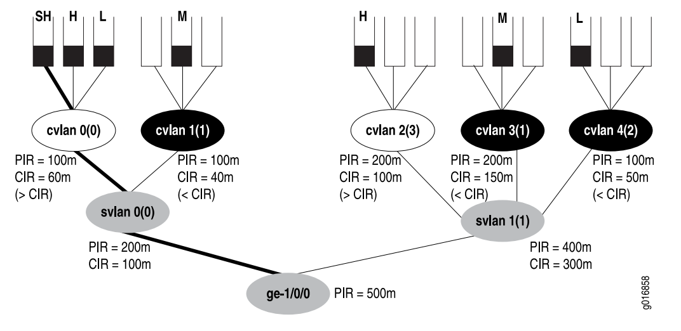
Hierarchical queue scheduler
Source https://www.juniper.net/documentation/en_US/junos/information-products/pathway-pages/cos/config-guide-hierarchical-cos.pdf

Slide 20
“Congestion control” in quantum networks
End-points cannot get more end-to-end Bell pairs per second (Bpps) than network can produce them
based on bottleneck link or router.
Desire X Bpps
10 Bpps
10 Bpps
10 Bpps
10 Bpps
10 Bpps
Desire Y Bpps
Bottleneck link.
Cannot achieve desired end-to-end entanglements if X+Y > 10
(or even less considering non-deterministic swaps and distillation)

Slide 21
Reliable transport: error detection and recovery
This is an example of the go-back-N error recovery
1
2
Ack 1
Time-out
waiting for akc-2
based on estimate RTT
Retransmit packets +
Adjust congestion window
Dropped
(most likely due to congestion)
3
4
2
Retransmit
3
Retransmit
Ack 2
4
Ack 3
Retransmit

Slide 22
Error detection and recovery mechanisms
Checksums
To detect transmission errors
Classical networks are so reliable that the vast majority of drops are due to congestion
Automatic Repeat Request (ARQ)
Receiver sends an acknowledgement (ack) when it has correctly received the data
The sender re-transmits the data when it does not receive the ack
Not an option for quantum networks (requires that the sender keeps a copy until the data is acknowledged, in case the data needs to be retransmitted).
Go-back-N: resend all data starting at the dropped packet
Selective repeat: only resend the data that was dropped (requires selective ack)
Forward Error Correction (FEC)
When error rate is too high (noisy links)
When retransmission is delay is not acceptable (e.g. long latency satellite links)
The only option in quantum networks (quantum error correcting codes)

Slide 23
What is so difficult about this?
Flow control, congestion control, and error control are separate but closely related concepts
@@@

Slide 24
Flow control Congestion control Error control (reliability) in the control plane

Slide 25
Flow control matters in the control plane
Routing and signaling protocols exchange large volumes of data:
ISIS needs to flood tens of thousands of link state packets
BGP needs to send about 1 million routes to each neighbor
RSVP needs to signal tens of thousands of paths
It is important that the send does not overwhelm the receiver
ISIS most not flood link state packets to its adjacencies than they can process them
BGP must not send routes faster than the neighbor can process them
RSVP must not signal paths faster than the downstream router can process them
Approaches for flow control in routing and signaling protocols:
Pacing and burst parameters hard-coded into the implementation and/or configured by the operations: ISIS, OSPF, RSVP, …
Flow-control mechanism built into the protocol: proposed ISIS extension (draft)
Run over layer 4 protocol (TCP, SCTP, QUIC) and rely on flow-control provided by transport protocol: BGP, LDP, …

Slide 26
Congestion control matters in the control plane
Routing and signaling protocol packets always have strict priority over user data packets
Control protocol packets are still vulnerable to congestion
Because they compete with other control plane protocols
Congestive collapse of control protocols is not rare:
Link-state protocol adjacency comes up
Starts synchronizing a very large link-state database
Link becomes congested with link-state packets (all of them high priority)
Hello packets get dropped
Adjacency goes down
The cycle repeats itself (and congestion gets even worse because of it)
Solution: prioritize important traffic (hellos) within the protocol
Not so easy if you are running over TCP due to head-of-line blocking
This is why SCTP and QUIC added multi-stream support
Off-load liveness detection to a single extra-high priority protocol (BFD)

Slide 27
Error control matters in the control plane
When a routing or signaling protocol sends a control plane packet to a neighbor, it needs to make sure it is actually processed
Approaches for

Slide 28
“Radical” idea: run control plane over TCP
We need flow control, congestion control, error control
Layer 4 transport protocols (e.g. TCP) provide all these things
Why re-invent mechanisms in the protocol like ISIS or OSPF or RIP or RSVP?
Why not run routing and signaling protocols over TCP?
This is exactly what some protocols (BGP, LDP, etc.) do.
This seems self-contradictory:
TCP needs IP forwarding
IP forwarding needs the routing table to be filled
The IP routing table is filled by the routing protocol
Hence, the routing protocol cannot run over TCP???
Solution: EBGP only ro

Slide 29
Lessons for quantum control protocols
You need to worry about flow control
You need to worry about congestion control
You need to worry about error control
Not just in the data plane, but also in the control plane
Avoid re-inventing the wheel: rely on layer 4 transport when possible

Slide 30
Soft state versus Hard state

Slide 31
Soft state vs hard state
Sender wants to advertise some data (e.g. a route) to receiver.
Soft state protocol
A.k.a. Periodic protocol
Sender initially sends data.
Receiver puts data in its database.
Sender periodically resends data.
If receiver doesn’t receive data anymore, it removes data from its database after time-out.
Heavy load due to periodic transmission.
Fallacy: simpler cleanup when sender crashes.
Hard state state protocol
Runs protocol over reliable transport connection.
Sender initially sends data.
Receiver puts data in its database.
No periodic re-transmissions of data.
Receiver keep data in database until (a) sender explicitly withdraws data or (b) transport connection is disconnected.
No traffic if no changes in the database.
Needs reliable transport connection and keep-alive mechanism (typically runs over TCP)

Slide 32
Explosions and oscillations in your network

Slide 33
Packet replication loops
Packet replication Making multiple copies of a packet when you forward it (e.g. multicast) +
Forwarding loop
=
Network meltdown
Due to explosion of traffic

Slide 34
Packet replication loops
Packet replication Making multiple copies of a packet when you forward it (e.g. multicast) +
Forwarding loop
+
Absence of TTL mechanism
Packets can loop forever without TTL expiring
=
Disastrous nearly unfixable network meltdown
Due to explosion of traffic which doesn’t go away, even after you shut up the source

Slide 35
Example: Ethernet address learning + SPT
Packet replication Making multiple copies of a packet when you forward it (e.g. multicast) +
Forwarding loop
=
Network meltdown
Due to explosion of traffic

Slide 36
Triggered state machine loops

Slide 37
Run-away replication
Ethernet example

Slide 38
Undampened control feedback loops
Failed attempts at delay routing

Slide 39
Undampened state machine feedback loops
RIFT example

Slide 40
Multi version Multi feature Multi vendor

Slide 41
Interop between protocol versions
Version X needs to interoperate with version Y.
For any X and Y, not just Y = X + 1.
Don’t assume contiguous “regions” of same version.
Different devices will run different version of your protocol.
Temporarily during upgrade. You cannot upgrade your devices all at once; it takes a lot of time.
Or semi-permanently due to operational considerations (e.g. different vendors support different versions of the protocol). You want to be able to have multiple vendors in the same network.
Version 1
Version 2
Version 1
Version 1
Version 3

Slide 42
Lessons learned from major version bumps
IPv4 vs IPv6
IPv6 is not backwards compatible with IPv4
Upgrading from IPv4 to IPv6 is a royal pain in the neck
It’s been 20 years and IPv6 is still not universally deployed
IPv4 will never go away
OSPFv3 vs OSPFv2
OSPFv3 is not backwards compatible with OSPFv2
You need to upgrade from OSPFv2 to OSPFv3 to get IPv6
Real networks run OSPFv2 and OSPFv3
ISIS did it right (ISIS with IPv6 can interoperate with ISIS without IPv6)
BGPv3 vs BGPv4 vs …BGPv5?
BGPv3 is not backwards compatible with BGPv4, it required every Internet core router to be upgraded
Upgrading every core router on the Internet is infeasible at this time
BGPv4 has excellent extension mechanisms; it is unlikely that there will ever be a BGPv5

Slide 43
Interop between feature sets
Protocol implementation that has feature A must interoperate with protocol implementation that does not have feature A.
Different vendors and versions of code have different feature sets.
Don’t assume the feature set can be derived from the protocol version. Allows protocol extensions to evolve and be deployed independently.
Don’t assume the feature set is the same. Feature set A+B must interoperate with B+C.
A
D
B
C
C
D
A
B
D
A
B
C
Protocol features
A
B
C
D

Slide 44
Capability announcement (“negotiation”)
A
B
C
B
C
D
I support features A, C, D
I support features B, C, D
We can use features B, C (these are the ones we have in common)
We can use features B, C (these are the ones we have in common)
(Things get a bit more complicated when more than 2 devices are involved, e.g. flooding)

Slide 45
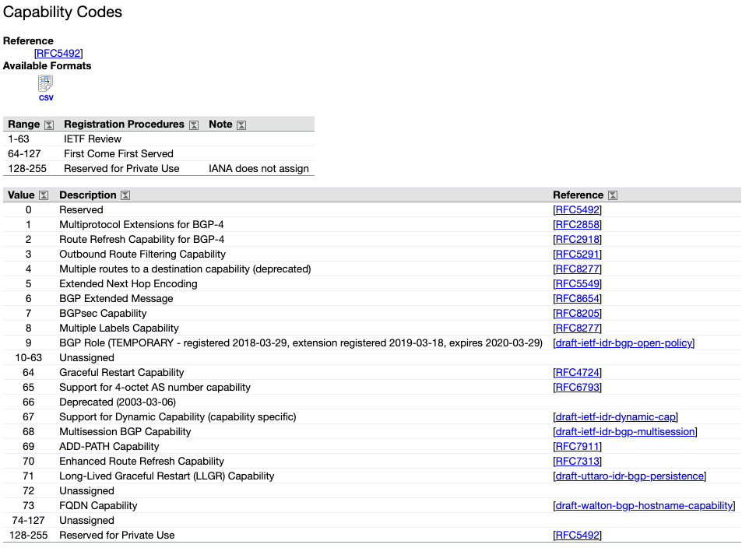
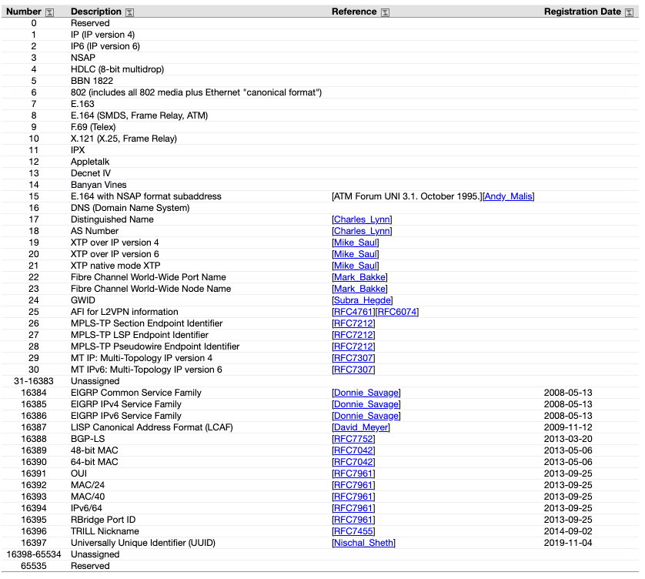
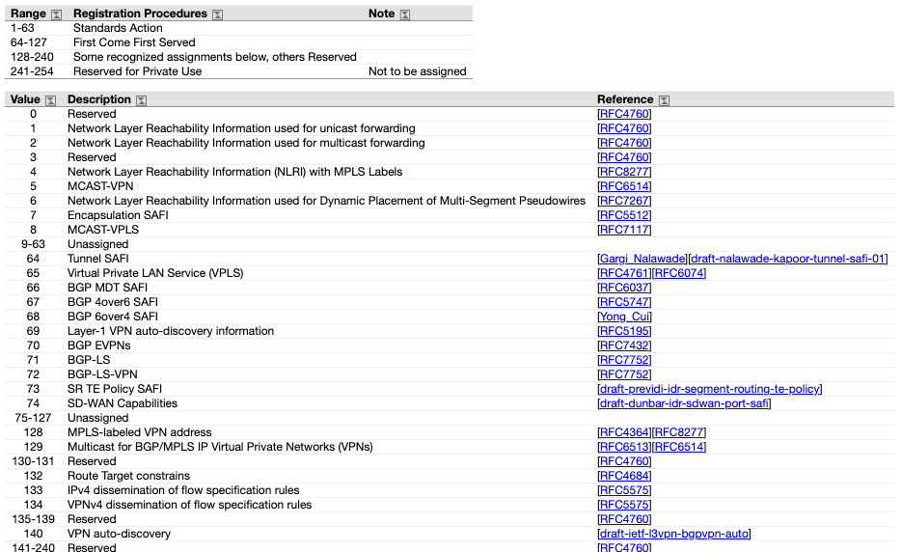
Example: BGPv4 capabilities

Slide 46
Type Length Value (TLV) Encoding

Slide 47
How to handle unrecognized TLVs?
What should you do when you receive a TLV with an unknown type?
Happens when another device is running a newer version of the protocol.
Options:
Ignore and propagate the TLV
Ignore and remove the TLV
Declare an error
Note: ignoring is possible because the length L is known and the value can be skipped
The originator of the TLV (who by definition understands it) sets some extra bits in the TLV to instruct the receiver what to do.

Slide 48
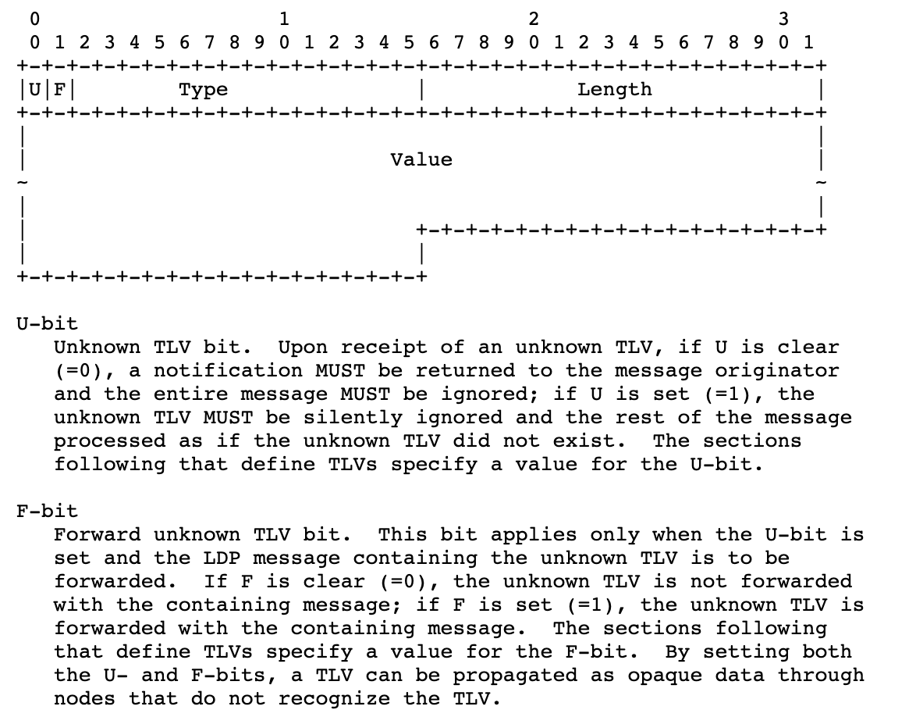
Example: Label Distribution Protocol (LDP)
TLV encoding is also used in:
BGP
OSPF
ISIS
RSVP
Many more…

Slide 49
Planned upgrades Unplanned crashes

Slide 50
Authentication vs encryption

Slide 51
Neighbor authentication

Slide 52
Origin authentication

Slide 53
Path authentication

Slide 54
Control protocol security

Slide 55
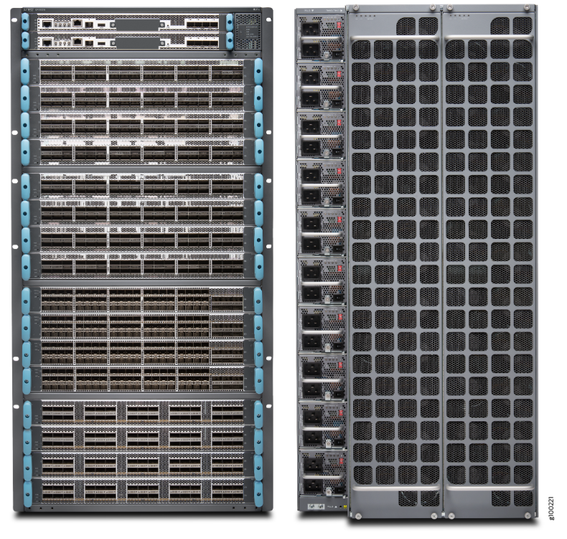
Chassis devices
Redundant control planes (routing engines)
Everything (routing engine, switch fabric, power supplies, fans, …) redundant and in-service replaceable

Slide 56
In-Service Software Upgrade (ISSU)
Active routing engine
Version 1
Active routing engine
Version 1
Active routing engine
Version 1
Active routing engine
Version 2
Standby routing engine:
Version 1
Standby routing engine:
Version 2
Standby routing engine:
Version 2
Standby routing engine:
Version 2
Forwarding engine
Forwarding engine
Forwarding engine
Forwarding engine
Forwarding engine
Forwarding engine
Forwarding engine
Forwarding engine
Upgrade
standby
Switch-over
Upgrade
new standby

Slide 57
Non-Stop Forwarding (NSF) Also known as Graceful Restart (GR)
Control-plane session
PREPARE FOR RESTART
Control-plane session PREPARE FOR RESTART
Active routing engine: version 1
Standby routing engine: version 2
Data-plane traffic
Forwarding engine
Data-plane traffic
Active routing engine: version 1
Control-plane session
RESYNCHRONIZE
Standby routing engine: version 2
Control-plane session RESYNCHRONIZE
Data-plane traffic
Forwarding engine STALE TABLES
Data-plane traffic
Active routing engine: version 1
Control-plane session
RESTART FINISHED
Standby routing engine: version 2
Control-plane session RESTART FINISHED
Data-plane traffic
Data-plane traffic
Forwarding engine

Slide 58
Pizza-box devices
Does not have redundant routing hardware routing engines.
(Sometimes in redundant software routing engines using virtual machines or containers.)

Slide 59
Non-Stop Routing (NSR)

Slide 60
Scale-out instead of scale-up

Slide 61
Relatively small impact of losing one device
For planned upgrades, announce in advance (e.g. overload flag) to shift traffic away, if possible.

Slide 62
Implementation correctness is hard. Much harder than you think.

Slide 63
Don’t hand-code your parsers
Type Length Value (TLV) encoding (we saw this before!)
Formal modeling language for on-the-wire protocol
Abstract Syntax Number 1 (ASN.1)
YANG
Google Protocol Buffers (BGP), Thrift, etc.
@@@ Example of real-life bug

Slide 64
Thank you.

Slide 65
References
Some lessons from history (“Those who do not know history are doomed to repeat it”) https://datatracker.ietf.org/meeting/102/materials/slides-102-rtgarea-those-who-do-not-learn-history-are-doomed-to-repeat-it-00

